Slide 1

CompSci 471
Shared Gridworld Lab
Artificial Intelligence
+10
Lesson 11: MDP Foundations
WALL
-10
Modeling decisions under uncertainty
START
State
Action
Transition
Reward
New state
Build the world before solving it.
Fall 2026
CS 471 | L11: MDP Foundations
1
Notes:
Emphasize that Lesson 11 builds the decision model. Algorithms come later.

Slide 2
Module 2 map
One decision model. Three ways to reason with it.
L11
L12
L13
L14
L15
L16
Build the
MDP world
Behavior,
return, value
Value
Iteration
Policy
Iteration
Q-
Learning
Workshop
+ Quiz 4
Today: describe the environment before asking an algorithm to solve it.
CS 471 | L11: MDP Foundations
2
Notes:
Orient students to the full module. Lesson 11 builds the model; later lessons describe behavior, compute values, and learn from experience.

Slide 3
Today’s mission
A strong MDP formulation separates what the agent knows, chooses, experiences, and values.
1
Define states, actions, transitions, and rewards.
2
Explain the Markov property.
3
Formulate a real-world problem as an MDP.
Performance target: given a new scenario, build S, A, T, R and explain whether the state contains enough information to predict what happens next.
CS 471 | L11: MDP Foundations
3
Notes:
Tie directly to the syllabus objectives. Keep the focus on formulation and Markov property rather than Bellman equations.

Slide 4
From search to MDPs
We are extending problem formulation, not replacing it.
Search
Expectimax
MDP
Action usually has
one modeled result
Solution: path
Action is chance with several possible outcomes
Solution: policy
Action may have
several possible resulting states
Solution: policy
outcome distribution
+10
+10
+10
+10
s′ | P(s′|s,a)
(1,2) | 0.15
(0,3) | 0.6
(0,1) | 0.25
WALL
-10
WALL
-10
WALL
-10
WALL
-10
START
one planned path
one action, multiple outcomes
Key question: What if taking the same action does not always produce the same next state?
CS 471 | L11: MDP Foundations
4
Notes:
MDPs extend the decision-under-uncertainty idea from expectimax into repeated sequential decision-making. Emphasize that MDPs add uncertainty, rewards over time, and policies. A deterministic sequence is insufficient when reality changes. The next decision should depend on what actually happened. Focus on a repeated action-observation cycle.

Slide 5
Shared Gridworld Lab
We will reuse one small world to make each algorithm visible.
+10
Environment
• Agent starts in the lower-left cell
• Gray cell is a wall
• Green terminal gives +10
• Red terminal gives -10
WALL
-10
START
Actions
↑ ↓ ← →
Today: identify the model. Later: compute or learn good behavior.
CS 471 | L11: MDP Foundations
5
Notes:
Introduce the running example in this block.

Slide 6
What information does an MDP need?
Every later algorithm assumes these pieces are clearly defined.
State
Action
current situation
agent choice
+10
WALL
-10
S, A, T, R
START
Transition
Reward
possible next states
+ probabilities
immediate score
CS 471 | L11: MDP Foundations
6

Slide 7
The MDP interaction loop
The agent chooses the action; the environment determines the outcome.
STATE s
ACTION a
Agent controls
observe
choose
which action is selected from the current state
Environment responds
REWARD r
NEXT s'
next state and reward according to the transition model
score
outcome
A policy will eventually tell the agent what action to choose in each state.
CS 471 | L11: MDP Foundations
7
Notes:
This is the anchor visual for Module 2. Distinguish agent control from environment response.

Slide 8
Probability checkpoint: one action, several outcomes
We only need enough probability to interpret uncertain transitions.
+10
0.80
intended
cell
WALL
-10
Current
state s
0.10
slip
west
START
0.10
slip
south
Action chosen: → East
Probabilities for a complete set of outcomes must add to 1.
CS 471 | L11: MDP Foundations
8

Slide 9
Reading transition notation
The notation is just a compact way to name a conditional probability.
P(s′ | s, a)
s
a
s′
|
current
state
chosen
action
possible
next state
given
Probability of reaching next state s′, given current state s and action a.”
Formal conditional probability returns in Lesson 18.
CS 471 | L11: MDP Foundations
9
Notes:
“How likely is this next state if we are here and take this action?” Unpack this verbally and tell students conditional probability will be formally studied in L18.

Slide 10
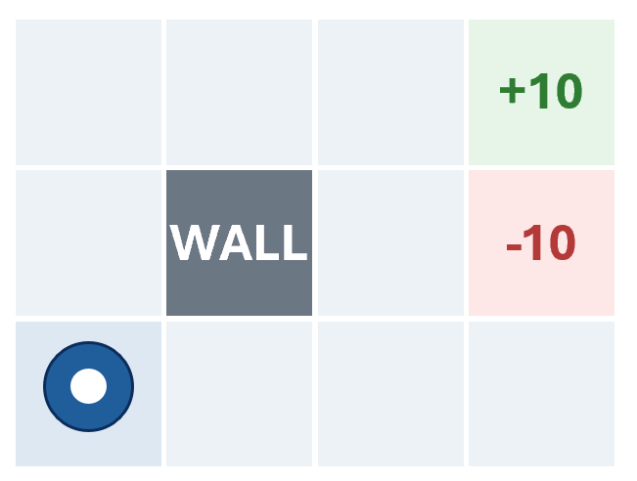
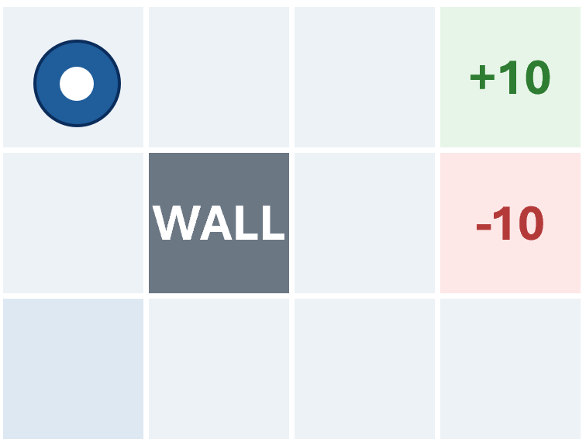
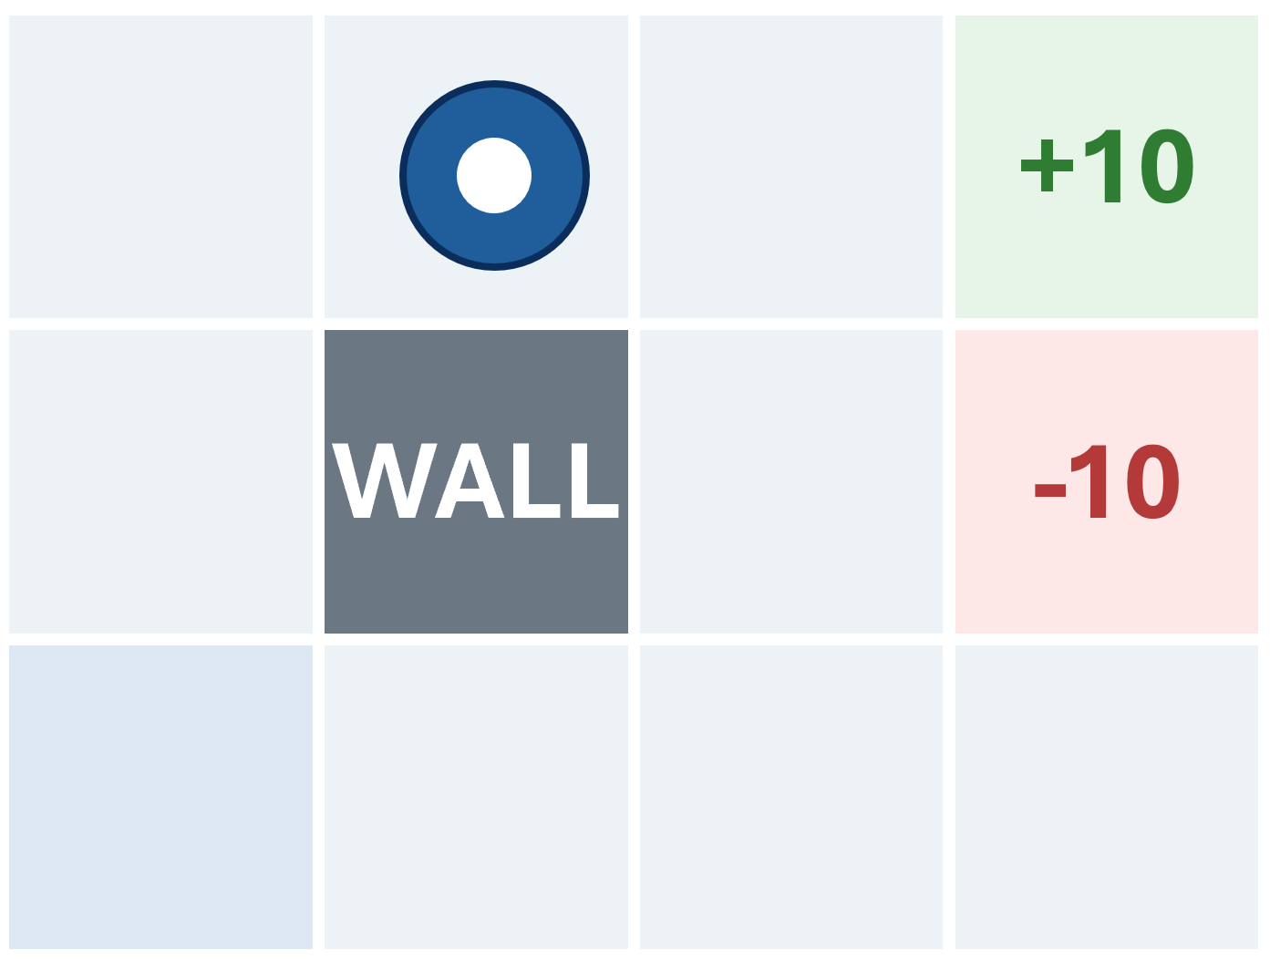
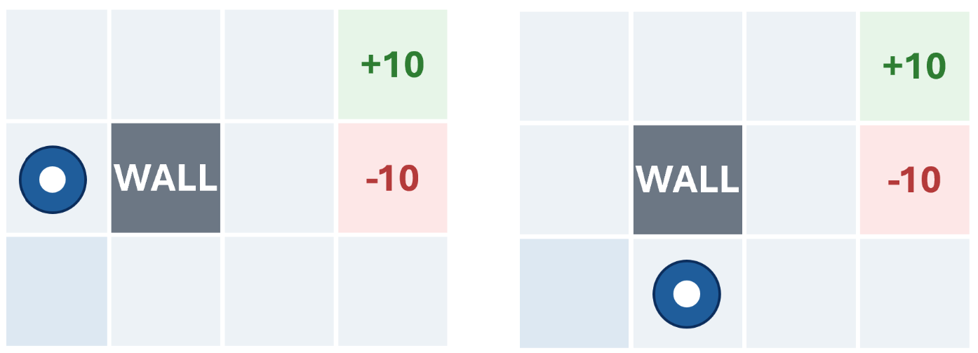
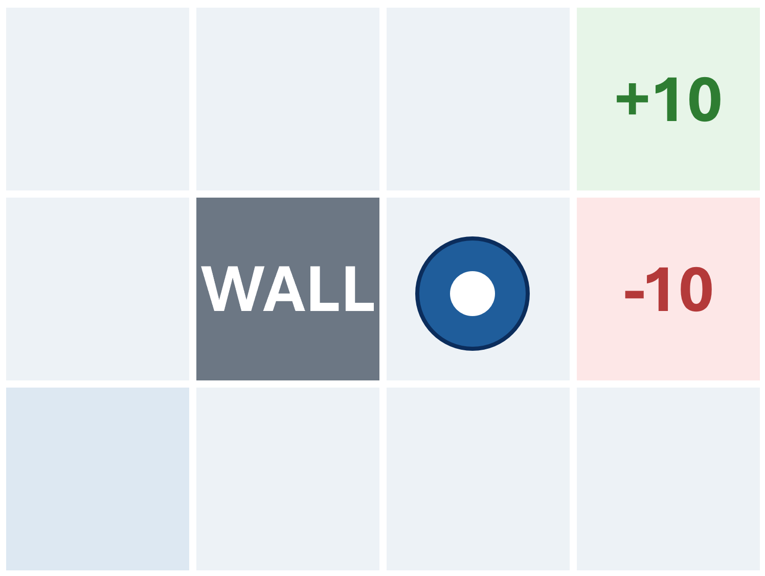
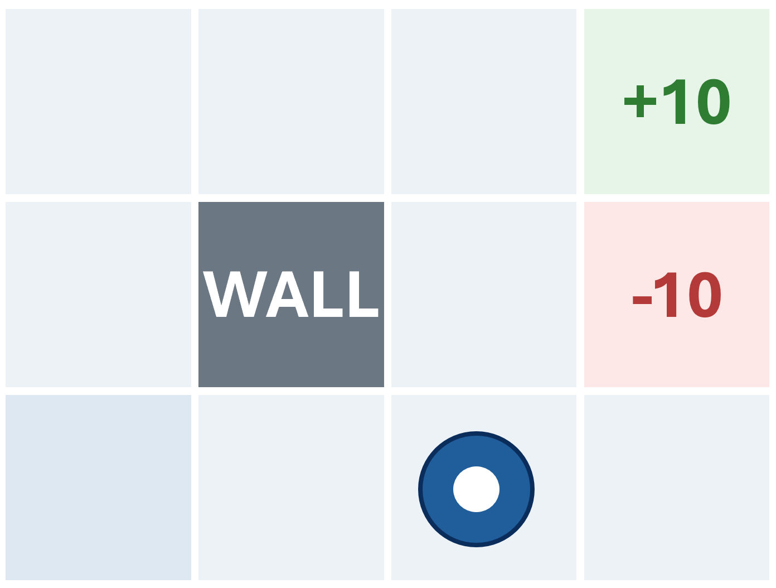
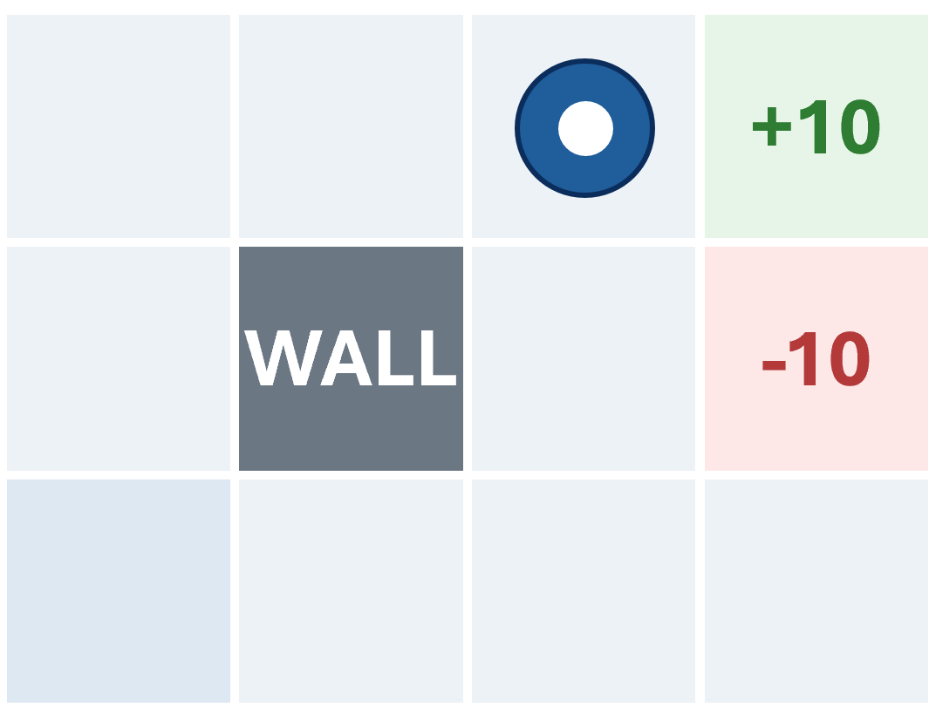
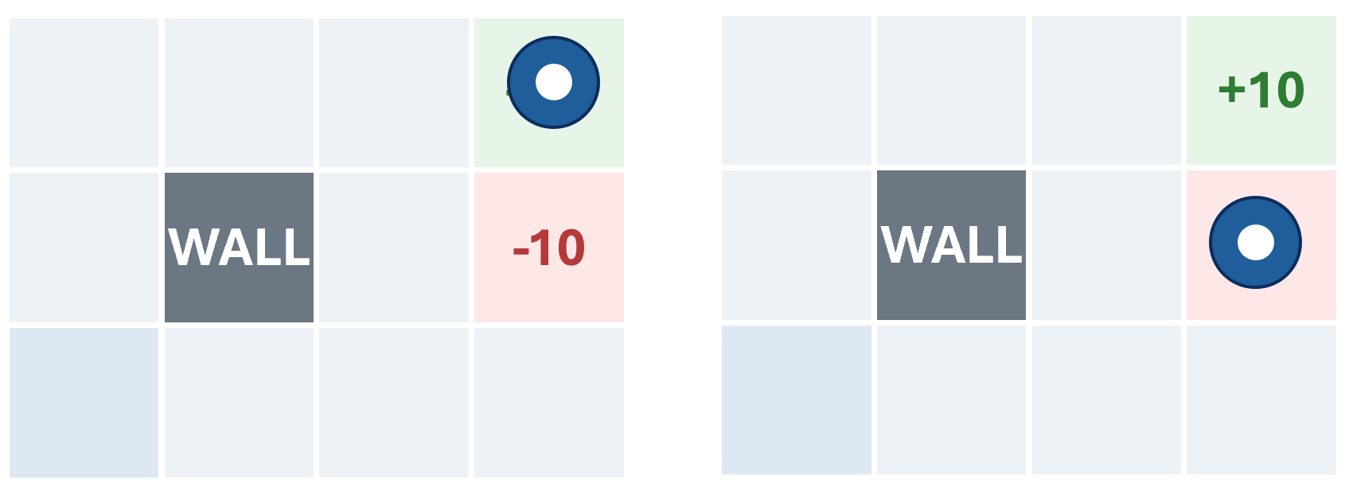
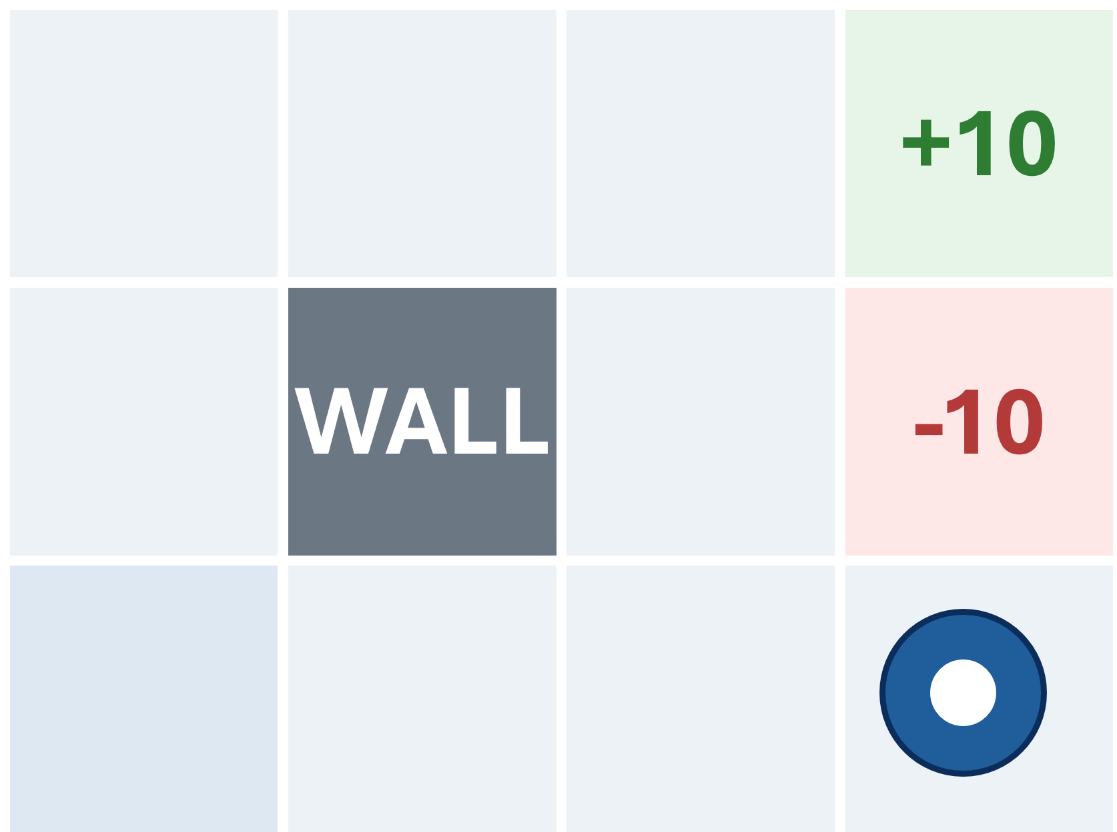












































The Gridworld as an MDP graph
A state graph compactly represents the MDP
0.2
0.8
0.3
0.7
This is the world model—not a record of one particular run.
CS 471 | L11: MDP Foundations
9
Notes:
States are represented once, actions connect states to possible outcomes, edge labels encode transition probabilities, cycles are allowed.

Slide 11

Unrolling a decision
This tree looks similar to expectimax
Current
state s
North
East
0.2
0.8
0.3
0.7
0.80
intended
cell
0.20
slip
east
0.30
slip
north
0.70
intended
cell
The local decision structure is familiar. What changes is that an MDP keeps going.
CS 471 | L11: MDP Foundations
9
Notes:
MDP unfolds like an expectimax search tree, but instead of making just one best-expected value decision for a single state, we are looking further at policies for each state.

Slide 12
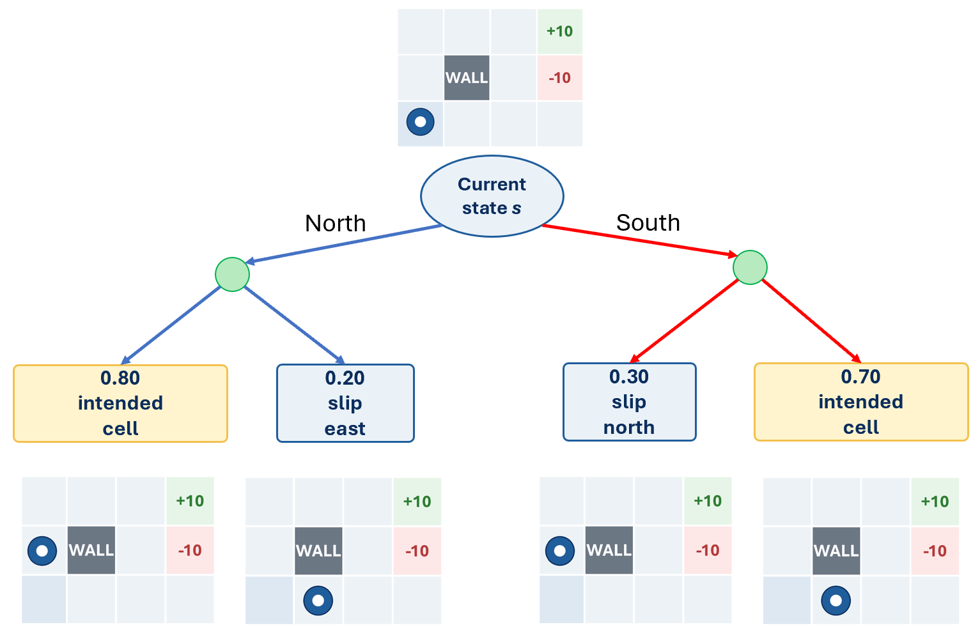

Graph vs. tree
The graph stores the problem; the tree unfolds possibilities through time
…
…
Compact model
One node per state
States can be revisited
Cycles are natural
Reusable across decisions
Unrolled futures
Same state may appear many times
Depth represents future decisions
Tree grows rapidly
Finite lookahead requires a horizon
MDP methods reuse what we learn about a state instead of solving an enormous new tree every time we encounter it.
CS 471 | L11: MDP Foundations
9
Notes:
We don’t expand the tree forever because states repeat, decisions repeat, and the tree can grow without bound.

Slide 13
The four MDP components
Use these questions to formulate any sequential decision problem.
State S
Transition T
What situation are we in now?
What might happen next?
Action A
Reward R
What can the agent choose?
How desirable was the immediate outcome?
CS 471 | L11: MDP Foundations
10
Notes:
Introduce S, A, T, R conceptually. Avoid policies and values until Lesson 12.

Slide 14
State = decision-relevant snapshot
A state should contain information needed for the next decision.
+10
+10
battery 12%
sensor fault
WALL
-10
WALL
-10
START
START
s = (row, column)
s = (row, column, battery, sensor)
In a simple Gridworld, location may be enough.
In real systems, hidden variables may change transitions or rewards.
CS 471 | L11: MDP Foundations
11

Slide 15
State representation still matters
Too little information breaks prediction; too much information adds needless complexity.
Too little
Useful abstraction
Too much
“operating normally”
Cannot predict fuel, demand,
or risk.
battery, generator,
demand, solar condition
Supports decisions and
transition prediction.
every sensor reading,
serial number, operator name
May add complexity without
changing decisions.
MDP state must support prediction, not just description.
CS 471 | L11: MDP Foundations
12
Notes:
Connection to Lesson 4: states are still abstractions—but now they must also support prediction.

Slide 16
Actions are choices, not conditions
Separate what the agent chooses from what the environment returns.
Action
Not an action
Move East
Start generator
Shed noncritical load
Transmit data
Battery at 20%
0.30 probability of failure
+10 reward
Generator starts successfully
Action = what the agent can intentionally select.
CS 471 | L11: MDP Foundations
13
Notes:
Is this under the agent’s control as a choice?

Slide 17
Transition model = possible outcomes + probabilities
The action is one choice; the transition is a distribution over next states.
P(s′ | s, a)
+10
0.80 → intended cell
WALL
-10
Action:
Move East
0.10 → slips upward
START
0.10 → slips downward
Action chosen: → East
Transition probabilities describe uncertainty in what happens next.
CS 471 | L11: MDP Foundations
14
Notes:
Quick check: do the probabilities add up to 1?

Slide 18
Rewards score immediate outcomes
Reward is the numerical consequence attached to what just happened.
Positive
+10
+10 for reaching the mission goal
WALL
-10
Negative
-10 for entering the hazard
START
Living reward
-1 each time step to encourage efficiency
Immediate reward is not the same thing as total long-term value.
CS 471 | L11: MDP Foundations
15
Notes:
Do not introduce cumulative return yet. Keep reward immediate. It is not yet “how good the future is;” that comes next lesson.

Slide 19
Transition tells what happened; reward tells how we score it
Keep the event and the evaluation separate.
Action: Move East
Probability
Transition outcome
Reward
80%
arrive in intended cell
-1
10%
slip near hazard
-1
10%
slip into hazard
-10
Later algorithms combine these pieces into long-term value.
CS 471 | L11: MDP Foundations
16
Notes:
Not every transition is random; some actions are deterministic and have prob 1 for one next state.

Slide 20
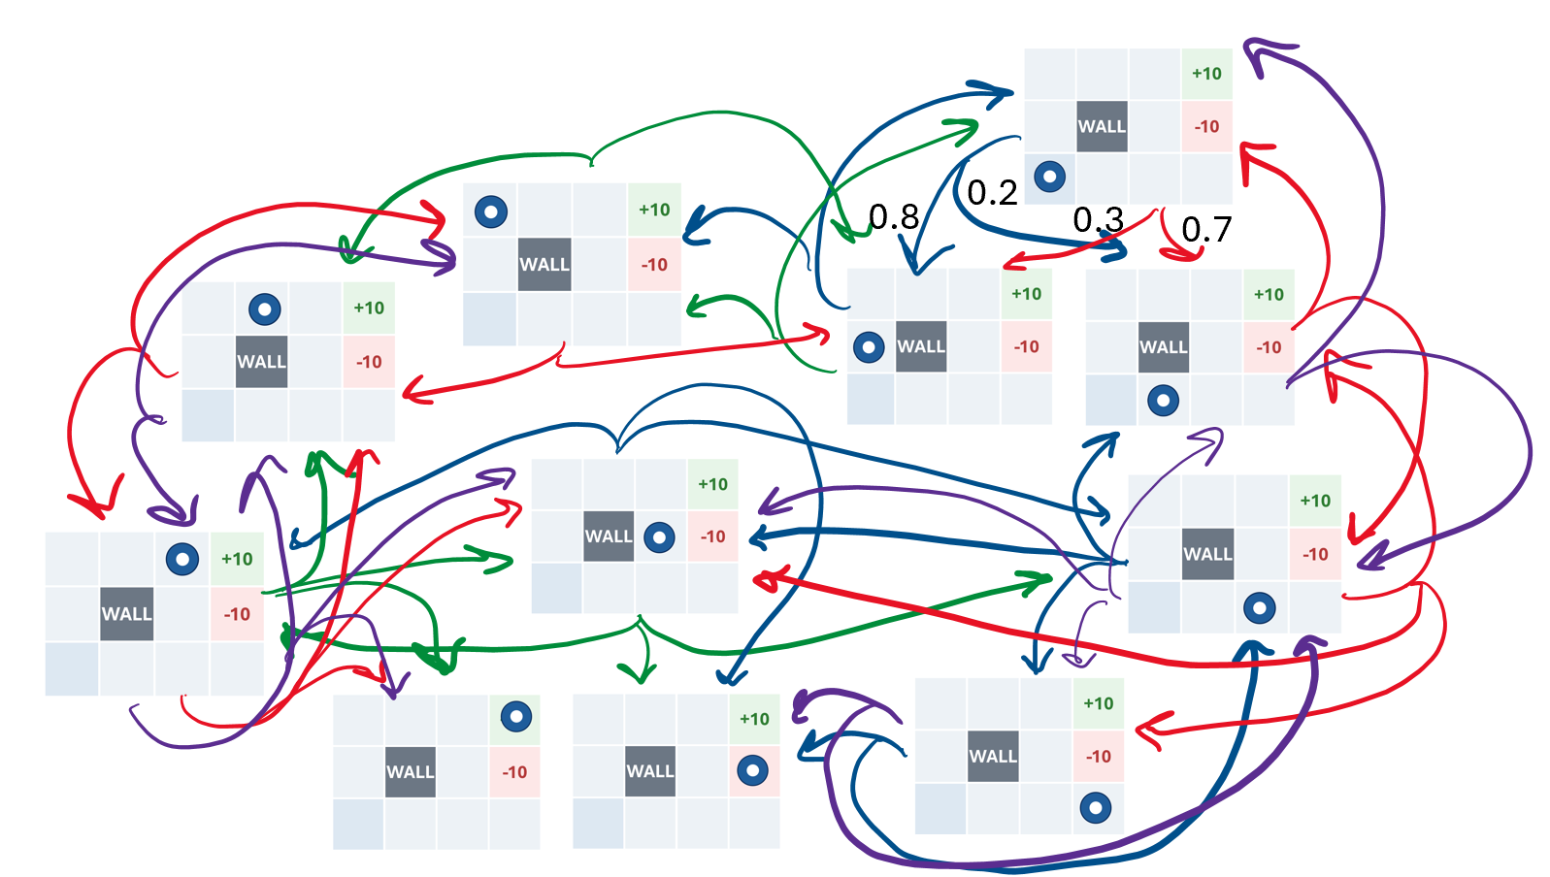
Assemble the Gridworld MDP
A complete formulation lets later algorithms reason consistently.
+10
S
grid cells plus terminal states
WALL
-10
A
↑, ↓, ←, → when legal
T
1 – (0.1 * n) intended, 0.1 * n slip one of n directions
START
R
+10 goal, -10 hazard, -1 living reward
Formulation is an engineering design choice.
CS 471 | L11: MDP Foundations
17
Notes:
This complete specification is what the graph represents.

Slide 21
Transfer: expeditionary microgrid controller
The same MDP vocabulary applies outside Gridworld.
State
Actions
Transitions
Rewards
battery level
generator status
demand
solar condition
use battery
start generator
charge
shed load
clouds arrive
demand spikes
generator fails
battery drains
mission power
fuel cost
safety
outage penalty
Gridworld teaches the structure; mission systems show why the structure matters.
CS 471 | L11: MDP Foundations
18

Slide 22
The Markov question
Does the current state tell us enough to predict what happens next?
Recorded state: “generator is OFF”
Situation A
Situation B
fuel high
generator cool
battery healthy
fuel nearly empty
generator overheated
battery low
Same recorded state + same action can produce different transition probabilities.
CS 471 | L11: MDP Foundations
19
Notes:
Introduce Markov property through a state insufficiency example rather than the equation first.

Slide 23
The Markov property
Relevant history should be summarized into the present state.
Once the current state and action are known, additional history should not be needed to predict the next-state distribution and immediate reward.
P(s_{t+1}, r_{t+1} | s_{t}, a_{t}, history) = P(s_{t+1}, r_{t+1} | s_{t}, a_{t})
Markov does not mean the past never matters. It means the relevant effects of the past are encoded now.
CS 471 | L11: MDP Foundations
20
Notes:
Give the student-friendly definition first. The equation is secondary.

Slide 24
Repair the state, not the definition
If hidden history changes outcomes, add the variables that carry its effects.
Incomplete state
Improved state
s = (location)
s = (location, battery, sensor status, mission deadline)
Reason
Battery and sensor status change which actions are available, which outcomes are likely, and how rewards should be scored.
Add information because it changes prediction—not because it is merely available.
CS 471 | L11: MDP Foundations
21
Notes:
Correct the misconception. Markov means relevant historical effects are encoded in the state.

Slide 25
The Markov test
Use this checklist when a proposed state representation seems too simple.
1
What actions are available?
2
After an action, what next states are possible?
3
Can we assign appropriate transition probabilities?
4
Can we determine the immediate reward?
5
Would additional history change any answer above?
If #5 is yes, the state may be incomplete.
CS 471 | L11: MDP Foundations
22

Slide 26
Practice: debug the MDP
Find the category errors before trying to solve the problem.
Pairs: repair the formulation and decide whether “current field” is Markov.
Autonomous farming robot
State
current field
• Weather is not an action.
• Reward should be numerical.
• Transition describes resulting states.
• State may need soil moisture and forecast.
Action
current weather
Transition
reward +5
Reward
crop becomes healthier
CS 471 | L11: MDP Foundations
23
Notes:
Run as a pair or small group activity. Students correct MDP components and discuss Markov sufficiency.

Slide 27
Practice: MDP formulation sprint
Build a compact model from a new scenario.
A coastal monitoring buoy decides whether to transmit data, conserve power, or run diagnostics. Battery charge, weather, and sensor status affect the result.
S
reasonable state
A
two actions
T
one action with two outcomes + probabilities
R
one positive and one negative reward
M
one Markov-property sentence
Goal: a model clear enough that another team could evaluate it.
CS 471 | L11: MDP Foundations
24
Notes:
Give 3-4 minutes. Emphasize construction plus Markov explanation.

Slide 28
Synthesis: what did we build?
An MDP is the decision environment that later algorithms solve or learn from.
S
state = ______________________________
+10
A
action = ______________________________
WALL
-10
T
transition = ______________________________
START
R
reward = ______________________________
M
Markov state = ______________________________
Next: once the environment is modeled, how do we describe good behavior over time?
CS 471 | L11: MDP Foundations
26

Slide 29
Exit ticket
Complete before you leave.
Scenario
A coastal monitoring buoy controller decides whether to transmit data, conserve power, or perform diagnostics.
Battery charge, weather, and sensor status affect the result.
One reasonable state representation is…
One action available to the agent is…
One possible outcome of that action is…
One immediate reward could be…
This state is / is not Markov because…
Preview L12: policies, return, and value.
CS 471 | L11: MDP Foundations
27

